Slide 1
Mission Statement:
At Westgate, we celebrate each other and grow as a community of lifelong learners and leaders.
Notes:
1

Slide 2
Our Class Mission Statement:
Notes:
2

Slide 3
My Mission Statement
My goal is to create a classroom community where all students are comfortable and have a sense of belonging. I want students to feel that all teachers and staff are available to them and are invested in their social, emotional, and academic needs.

Slide 4
Getting Information
E-mail:
Wendy Danley-wdanley@sd25.org
Classroom webpage: wdanley.weebly.com
Notes:
4

Slide 5
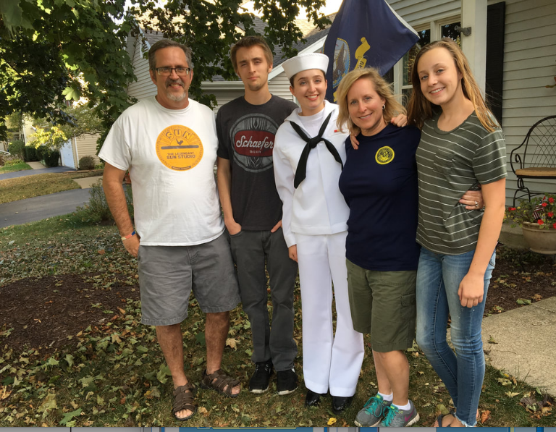

Slide 6
3rd Grade Buzz Words:
Responsible, independent, leaders
Every child makes great gains.
Please encourage, empower, and support your child who will take on more responsibilities, and will become more independent.

Slide 7
Daily Academic Schedule

Slide 8
Please make sure that your child arrives at school by 9:05 a.m.
Attendance
Announcements and Daily Schedule
Specials often begin right away at 9:10
Notes:
8

Slide 9
Specials
Wednesday/Friday: Music & PE
Music- Mrs. Witt
P.E.- Mr. Kirschner
Classroom Assistant- Mary Beth Michaels
Thursday: LMC- Mrs. Mazolla
Wednesday: ART- Mrs. Miller
Notes:
9

Slide 10
15 Minute Recess
We have morning recess on days we don’t have PE-
(Monday, Tuesday, Thursday)

Slide 11
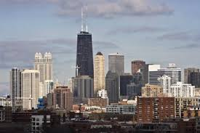
Science
Landforms
Weather
Forces and Motion
Traits & Inheritance
Social Studies
Chicago
Illinois & Midwest
Rules & Decision Making
Banks & the Economy

Slide 12
Snack Policy
*Fruits and Veggies in their own skin
*No nuts and tree nuts
*Easy Clean-Up
Notes:
12

Slide 13
Literacy Block
1. Schoolwide Literacy Reading Fundamentals:
Reading Workshop Structure:
Interactive Read-Aloud
Mini-Lessons
Guided and individual reading groups
Notes:
13

Slide 14
12:10-1:10 p.m.
Lunch & Recess

Slide 15
Writing
Be A Writer
Unit 1: Establishing a
Writing Community
Unit 2: The Writing Process
-Narrative
- NonFiction
-Opinion
-Fiction

Slide 16
Math Block
Math In Focus
(Singapore Math)

Slide 17
Math Workshop
Whole Group Mini-Lesson:
Problem of the day
Exit Slips to check for understanding
Small Group Instruction/Math Centers/fact practice:
Review of mini lesson
Skills-based groups
Math Centers
Fact Practice
Notes:
17

Slide 18
W.I.N. Time
*What I Need
*Last 30 minutes of the day
*May switch classes based
on needs
Notes:
18

Slide 19
Classroom Management

Slide 20
Class Dojo
Dojo points based on the 7 Habits of Leader in Me:
Be Proactive
Begin with the End in Mind
Put First Things First
Think Win-Win
Seek First to Understand, Then to be Understood
Synergize
Sharpen the Saw (PE)

Slide 21
Student-led conferences in the spring

Slide 22
Homework
Weekly Homework:
-Choice Sheet
Work to finish may include:
math workbook
reading activity
spelling practice

Slide 23
Communication
*Student Monthly Newsletter
*Seesaw
*Email
*Class Dojo
Notes:
23

